Slide 1
How can CNN efficiently utilize quantum layers?
Vishal Bajpe
Anna Phan
https://github.com/qiskit-community/qiskit-hackathon-korea-22/issues/32

Slide 2

CNN: Convolutional Neural Network
CNN is a type of artificial neural network used to analyze visual images.
[Source] What is QCNN? | Author Pin Insight.

Slide 3
QCNN: Quantum Convolutional Neural Network
QCNN is a combination of a quantum computing system and a CNN model.
[Source] arXiv:2009.09423v1 [quant-ph] 20 Sep 2020

Slide 4
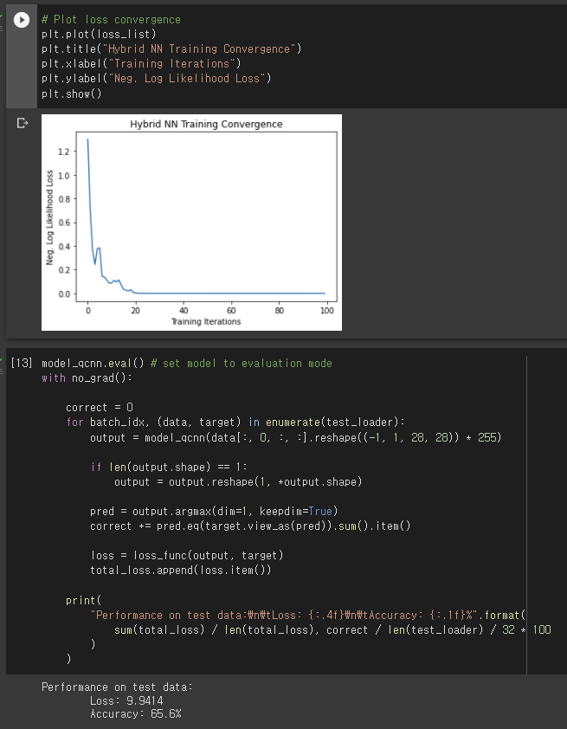
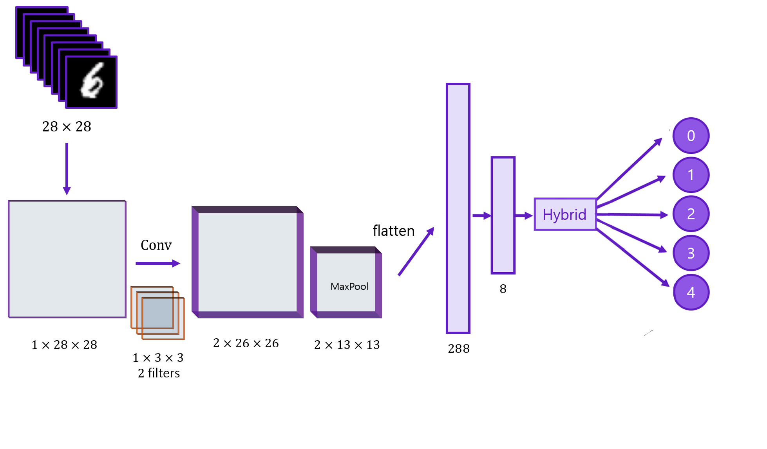
Find the best efficient way of using quantum layer in convolution neural network.
We use Hangeul (Korean alphabet), Sign language.

Slide 5
Problems.
1. Training the Qcnn model spends too long since we could not use qiskit_gpu_simulator.
2. Problems to transpile circuit to backend.
So we opened an issue in the qiskit machine learning github repo to point the problem.
Error training on GPU backends using Torch Connector · Issue #310 · Qiskit/qiskit-machine-learning (github.com)

Slide 6


Slide 8


